Slide 1
ROTATIONAL KINEMATICS, CENTRIPETAL FORCE AND GRAVITATION
NJ-OER TOPIC-6

Slide 2
Learning Outcomes
Define arc length, angular displacement, radius of curvature, angular velocity and angular acceleration Apply kinematics equations for rotational motion Establish the expression for centripetal acceleration. Identify the central force that causes centripetal acceleration Apply rolling condition to acceleration velocity and displacement Explain gravitational force between planets, stars and sattellites Calculate escape velocity Use Keppler's third law to calculate period or distance from a star for a planet.

Slide 3
Concepts
𝜃i= final angular displacement 𝜃f= final angular displacement 𝜔i= initial angular velocity 𝜔f= initial angular velocity α= angular acceleration 𝜔avg= average angular velocity 𝛼avg = average angular acceleration t = time Δ ω= change in angular velocity Δ θ= angular displacement Δ t =change in time s = distance travelled/arclength r = radius | vT= tangential velocity aT= tangential acceleration ac = centripetal acceleration F_{c} = centripetal force Fn= Normal Force Ft= Force of tension f= friction g= gravitational acceleration G = Universal gravitational constant m = mass vesc= Escape velocity T = Time Period of a planet K_{s} = Kepler’s constant

Slide 4
Units
SI UNITS Position, displacement, radius are in meters “m” Velocity and speed are in meters per second “m/s” Acceleration is in meters per second square “m/s²” angular displacement is in “radians” angular velocity is in “ rad/s” angular acceleration in “rad/s²” Force in Newton’s”N” time and period are in seconds mass is in kg

Slide 5
Formulas and Constants
Δθ=(ωf+ωi)t/2 ωavg=(ωf+ωi)/2 Δθ=ωi t + ½ αt² ωf=ωi+αt ωf²=ωi²+2αΔθ As a convention, for ωf,ωi,α and Δθ clockwise is negative counter clockwise is positive ωf=ω and ωi=ωo when ti=0 s=rΔθ vT=rω aT=rα a_{c =} v²/r a_{c} = rω² a² = (a_{c})² +(a_{t})² F_{c}= Σ F use only central and radial forces F_{c} = m v²/r F_{c} = m ω²r | g=GM/R² v²=GM/R P.E=−GMm/R T²= 4π²GMR^{3/2} T² = Ks r³ T₁ ² / r₁ ³ = T₂ ² /r₂ ³ G = 6.673 10⁻¹¹ N m² /kg ²

Slide 6
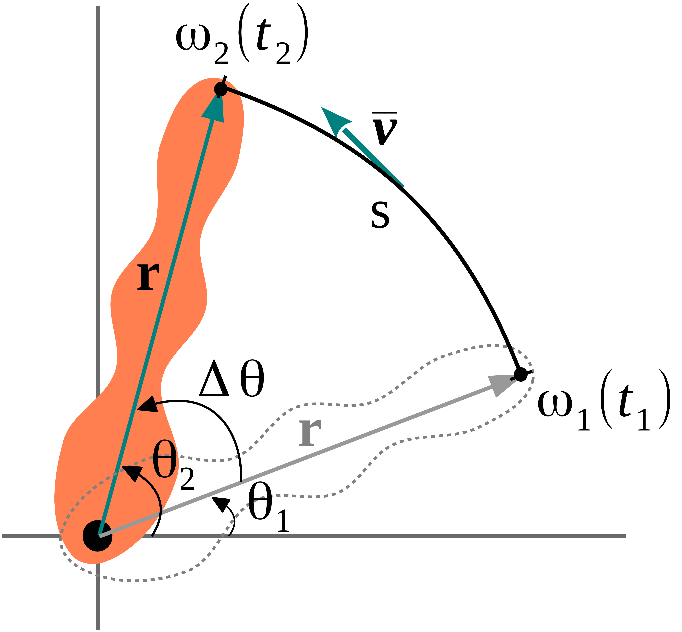
ROTATIONAL KINEMATICS IMPORTANT TABLES
Rotational | Translational
Δθ=ωavg t | Δx=vavg t
ω=ω₀+αt | v=v₀+at | constant α
Δθ=ω₀t+½ αt² | Δx=v₀t+½ at² | constant α
ω²=ωo²+2αΔθ | v²=vo²+2aΔx | constant α
Degree Measures | Radian Measure
30º | π/6
60º | π/3
90º | π/2
120º | 2π/3
135º | 3π/4
180º | π
As a convention, for ωf (ω),ωi (ωo),α and Δθ clockwise is negative and counter clockwise is positive.
They should be treated as vectors

Slide 7
KEY STRATEGIES
There are 5 variables and 3 equations. Each equation is missing one variable. Δθ=ωi t + ½ αt² This equation can't be used for finding ωf ωf=ωi+αt This equation can't be used for finding Δθ ωf²=ωi²+2aΔθ This equation can't be used for finding t
Draw the motion diagram
Extract values from the word problem
Identify the unknowns
Find the right starting equation
Plug in the values and do the algebra
At rest means ωi=0
Stops means ωf=0
Constant angular velocity means α=0

Slide 8
CLASSWORK ON ROTATIONAL KINEMATICS
Q1) A drill has two modes. At the faster mode it turns with 30 radians/s and at the slower mode it moves with 20 radians/s. What should be the acceleration so that it would change from the faster mode to the slower mode in 50 turns. (1 Turn is 2pi in radians)
Q2) A wheel, rotating initially at an angular speed of 0.50 rad/s, accelerates over a 7.0-s interval at a rate of 0.040 rad/s². What is its angular speed after this 7.0-s interval? What is the angular displacement?
Q3) A wheel, rotating initially at an angular speed of 0.50 rad/s, decelerated over a 7.0-s interval at a rate of 0.040 rad/s². What is its angular speed after this 7.0-s interval? What is the angular displacement?
Q4) A disc rotating clockwise with angular speed 4.2 rad/s reverses its direction to rotate counterclockwise with 4.2 rad/s. What is the angular acceleration if change of direction happens in 4.0 seconds? What is the average angular velocity for this motion?
Q5) A hard disc at rest goes to its operational mode of 7200 RPM in 2.4 seconds. What is its operational angular velocity in rad/s and what should be its angular acceleration. 1RPM = (2π radians)/(60 seconds)
Δθ=ωi t + ½ αt² ωf = ωi + αt ωf²= ωi² + 2α Δθ

Slide 9
CLASSWORK ON ROLLING
Q) An automobile tire with radius 0.50 meters initially rolling with an angular velocity of 4 rad/s start to accelerate with a rate of a = 2.3 m/s².
a)What is the linear speed at the center of the tire and at the bottom of the tire in the beginning?
b)What is the angular acceleration
c) What is the final angular velocity and angular displacement after 3.2 seconds.
s=rΔθ
arc length, distance
vT=rω
tangential speed
aT=rα
tangential acceleration

Slide 10
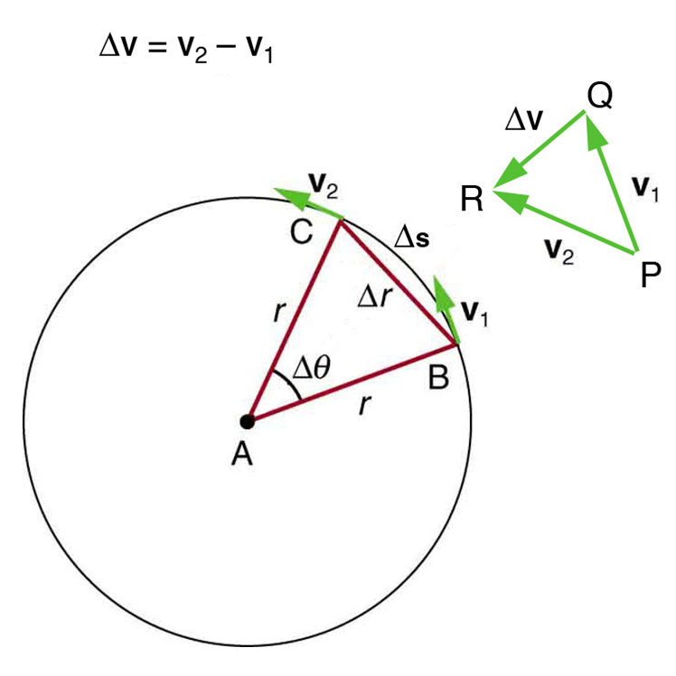
CENTRIPETAL FORCE PROBLEMS FIND THE MISSING FORCE
ac=v²/r Apply Newton's second law
Fc = m v²/r
Force equation could be misleading
For complex problems, you will not get Fc from Fc = m v²/r
You should get Fc from the free body diagram
RULES
1) Forces towards the center are positive
2) Forces away from the center such as radially outward forces are negative
3) Tangential forces which are perpendicular to the radial direction makes no contribution
4) For diagonal forces, take the component towards the center

Slide 11
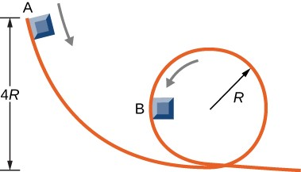
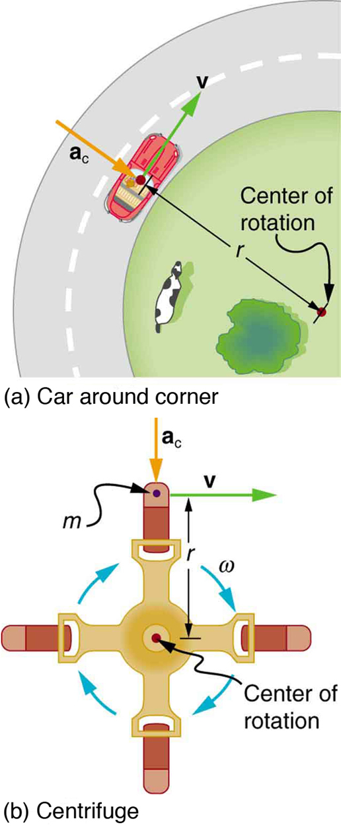
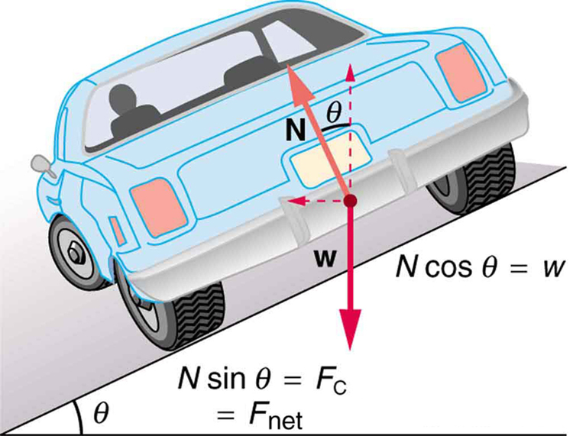
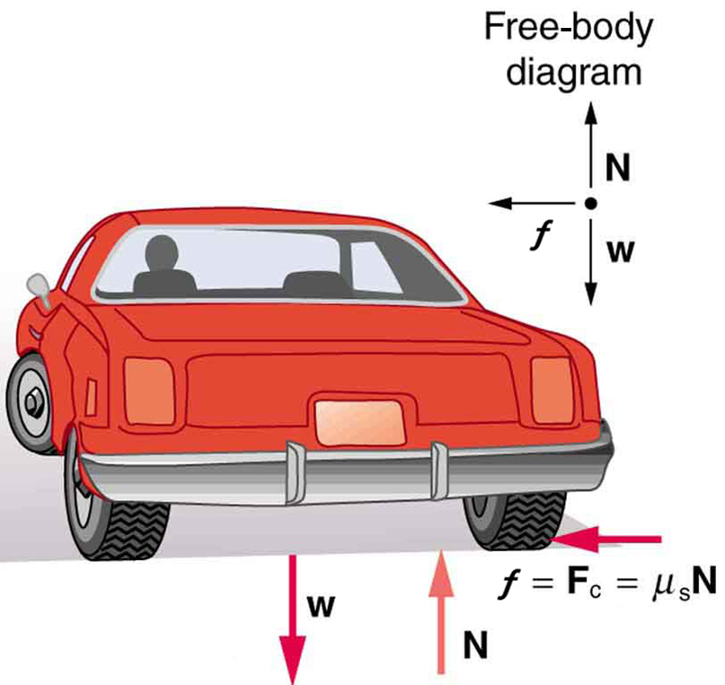
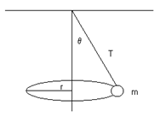
CENTRIPETAL FORCE
Banked curve, conical pendulum has diagonal forces. Use central component
Roller coaster or sliding mass problem.
Normal force depends on the position on the circular track. Object must be released from 4R to complete the cycle.
A car taking a curve
Fc= friction
Conical Pendulum
Fc=T sinθ

Slide 12
CLASSWORK CENTRIPETAL FORCE
Q1) A 80 kg passengers in a roller coaster car is moving in a circular loop of radius 10 m, which makes its passengers go upside down at the top.
a) What is the normal force exerted by the tracks if its velocity is 12 m/s at the top?
b) What is the normal force exerted by the tracks if its velocity is 18 m/s at the bottom?
Q2) A conical pendulum consists of a mass of 0.5 kg attached at one end of a string of length 1.0 m. The other end is fixed. As the mass moves in a circular path of radius 0.8 m, the string traces out the surface of a cone. What is the Tension on the string? What is the velocity? (Find the angle or sin(theta), cos(theta) first)
Q3) A 70 kg jet pilot is in a circular dive with the speed of 200 m/s moving in a radius of 4000 meters. What is the normal force that the seat is exerting on a pilot at the bottom of the circular dive?
Q4)A 0.60-kg rock is swung in a circular path and in a vertical plane on a 0.50-m-length string. At the top of the path, its speed is 4 m/s. What is the tension in the string at that point?
Q5) A 0.50-kg toy is rotated in a circular path of radius 1.5 meters on a horizontal table. What is the friction force when it has an angular speed of 2.0 rad/s? What is the minimum coefficient of friction so that it doesn't slide.

Slide 13
CLASSWORK GRAVITATION
1) Gravitational constant on the moon is 1/6 of the Earth’s gravity. Earth is 12 times more massive than moon. What is the ratio of radius of the moon to the radius of Earth? What is the escape velocity from the Moon.
2) A satellite moves in a circular orbit around earth at a speed of 5000 m / s
(a)Determine the distance of the satellite from the center of the Earth
(b)Determine the period of the satellites orbit.
(c) If the mass of the satellite is doubled, will the orbital speed increase, decrease of stay the same.
3) Calculate the speed and the distance from the center of the Earth for a geosynchronous satellite
4) The planet Mars has a satellite, Phobos, which travels in an orbit of radius 9.4 x10⁶m with a period of 7 hr 39 min. Calculate the mass of Mars from this information.
5) A planet X has a period around a star given as 27 years. Another planet Y is 8 times further away from the star. What is the period of that planet Y?
Ks= 4 π²/(G M) T² = Ks r³ T₁ ² / r₁ ³ = T₂ ² /r₂ ³ G = 6.673 10⁻¹¹ N m² /kg ²
g= GM/R² g1 R1² /M1 = g2 R2²/M2 vesc² = 2GM/R

Slide 14
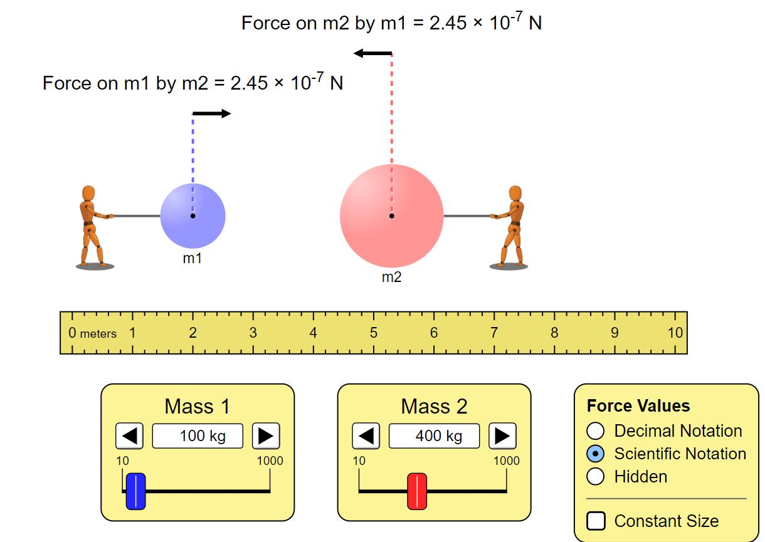
ACTIVITY GRAVITATIONAL FORCE
Open https://phet.colorado.edu/sims/html/gravity-force-lab/latest/gravity-force-lab_en.html
Adjust Masses and the distance.
Read the force from the app and compare with what you calculated
The distance between the mass M1 and M2 is R.
Use scientific notation
G=6.67 10⁻¹¹ Nm²/kg²
F(calculated) = G M1 M2/R²
M1(kg) | M2(kg) | R(m) | F(calculated) "N" | F(measured) "N"
100 | 400 | 4
400 | 400 | 4
400 | 400 | 2
200 | 500 | 8

Slide 15
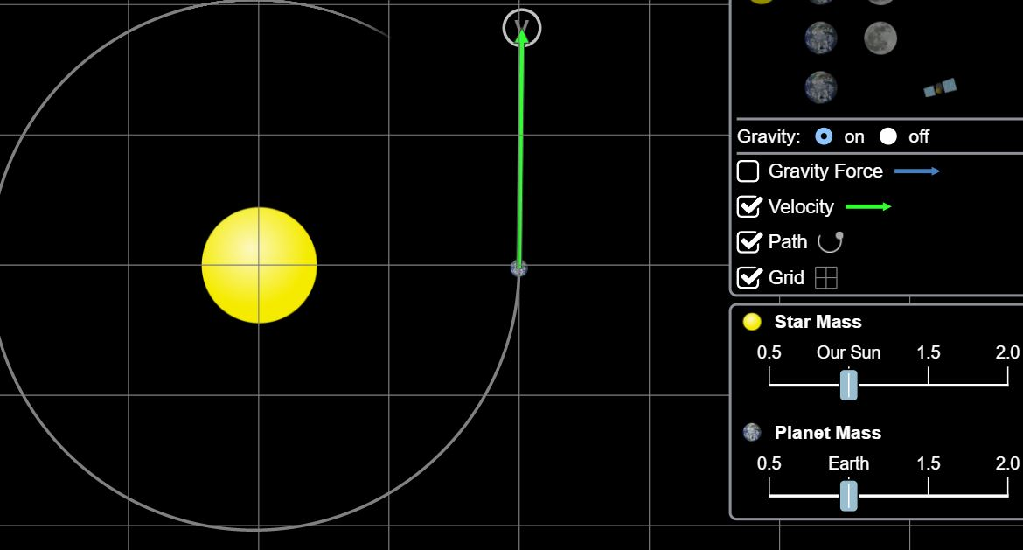
ADVANCED ACTIVITY KEPPLER'S LAW
Open https://phet.colorado.edu/en/simulation/gravity-and-orbits
Click on scale mode, from the options choose grids and velocity and path
Start the app, record the time for one full revolution.
The first trial will correspond to R1=2grids=1 astronomical unit (a.u) v=1.8 unit grids and the period is 1 year
1 a.u. = 1.5 10⁸ km, one grid is 7.5 10⁷ km. Theoretical Keppler's constant in this unit system is 1 Ks=1.
Change the starting distance R1 and the velocity based on the table below.
Record the distances for semi-major axis R1,R2 convert to a.u. Take the average and find the average distance R
Calculate the Keppler constant for each case using T²/R³ = Ks R is in a.u T is in years. Ks calculated should be close to 1.
R1(grids) | R1(a.u) | R2(a.u) | R | v | T(days) | T(years) | Ks
2 | 1 | 1 | 1 | 1.8 | 365 | 1 | 1
2.5 |  |  |  | 1.2
3 |  |  |  | 1
1 |  |  |  | 2.5

Slide 16
REFERENCES
Slide 1: Adobe id= 279663736 Solar system cartoon vector. Planets of solar system orbiting around sun on cosmic background with meteorites and asteroids, infographic illustration for school education or space ..By klyaksun
Slide 6: Adobe id= 441481751 Kinematic variables of rotational motion: Angular Displacement, Angular Velocity and Angular Acceleration By ScientificStock
Side 10-11: Open Stax College Physics online textbook
Slide 14-15 Screenshot from PhET Interactive Simulations University of Colorado Boulder https://phet.colorado.edu

